Slide 1


Tic- Tac-Toe

Slide 2
introduction
01.
Name: S M Uday Haider Department of Electrical and Computer Engineering Student ID: 2512062642
02.
Name: Kanij Fatema Lubna Department of Electrical and Computer Engineering Student ID: 2512430642
03.
Name: Asifur Rahman Apon Department of Electrical and Computer Engineering Student ID: 2512131642
04.
Name: Safin Ahmed Department of Electrical and Computer Engineering Student ID: 2511967642

Slide 3
abstract
Developing a console based version of Tic- Tac- Toe game is the main goal of this project. There can be three cases of conclusion in a 3x3 grid: win, loss and draw. Different fundamentals of C programming are used for making the game logic and establishing the conclusions. They are: arrays, loops, functions and conditionals. It is an ideal project to understand C programming in more diverse applications.
Project: 02 Team Member: S M Uday Haider, Kaniz Fatema Lubna, Asifur Rahman Apon, Safin Ahmed

Slide 4
How to play?
On the console, the players will be asked to input a number from 1 to 9 one after another. Each number is assigned for each block of the game and as an output, ‘X’ will be shown in the first player’s preferred block and ‘O’ will be shown in the second player’s preferred block. The result will be declared as per the horizontal, vertical and diagonal blocks. The first player who will mark their signs accordingly wins the game.
Project: 02 Team Member: S M Uday Haider, Kaniz Fatema Lubna, Asifur Rahman Apon, Safin Ahmed

Slide 5
THE SYMBOLS
player 1
player 2
Project: 02
Team Member: S M Uday Haider, Kaniz Fatema Lubna, Asifur Rahman Apon, Safin Ahmed

Slide 6
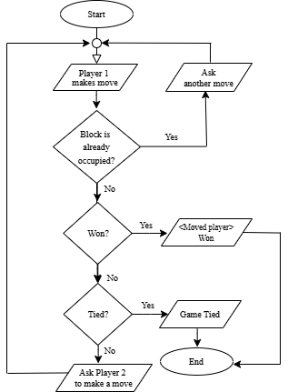
flowchart
Project: 02
Team Member: S M Uday Haider, Kaniz Fatema Lubna, Asifur Rahman Apon, Safin Ahmed

Slide 7
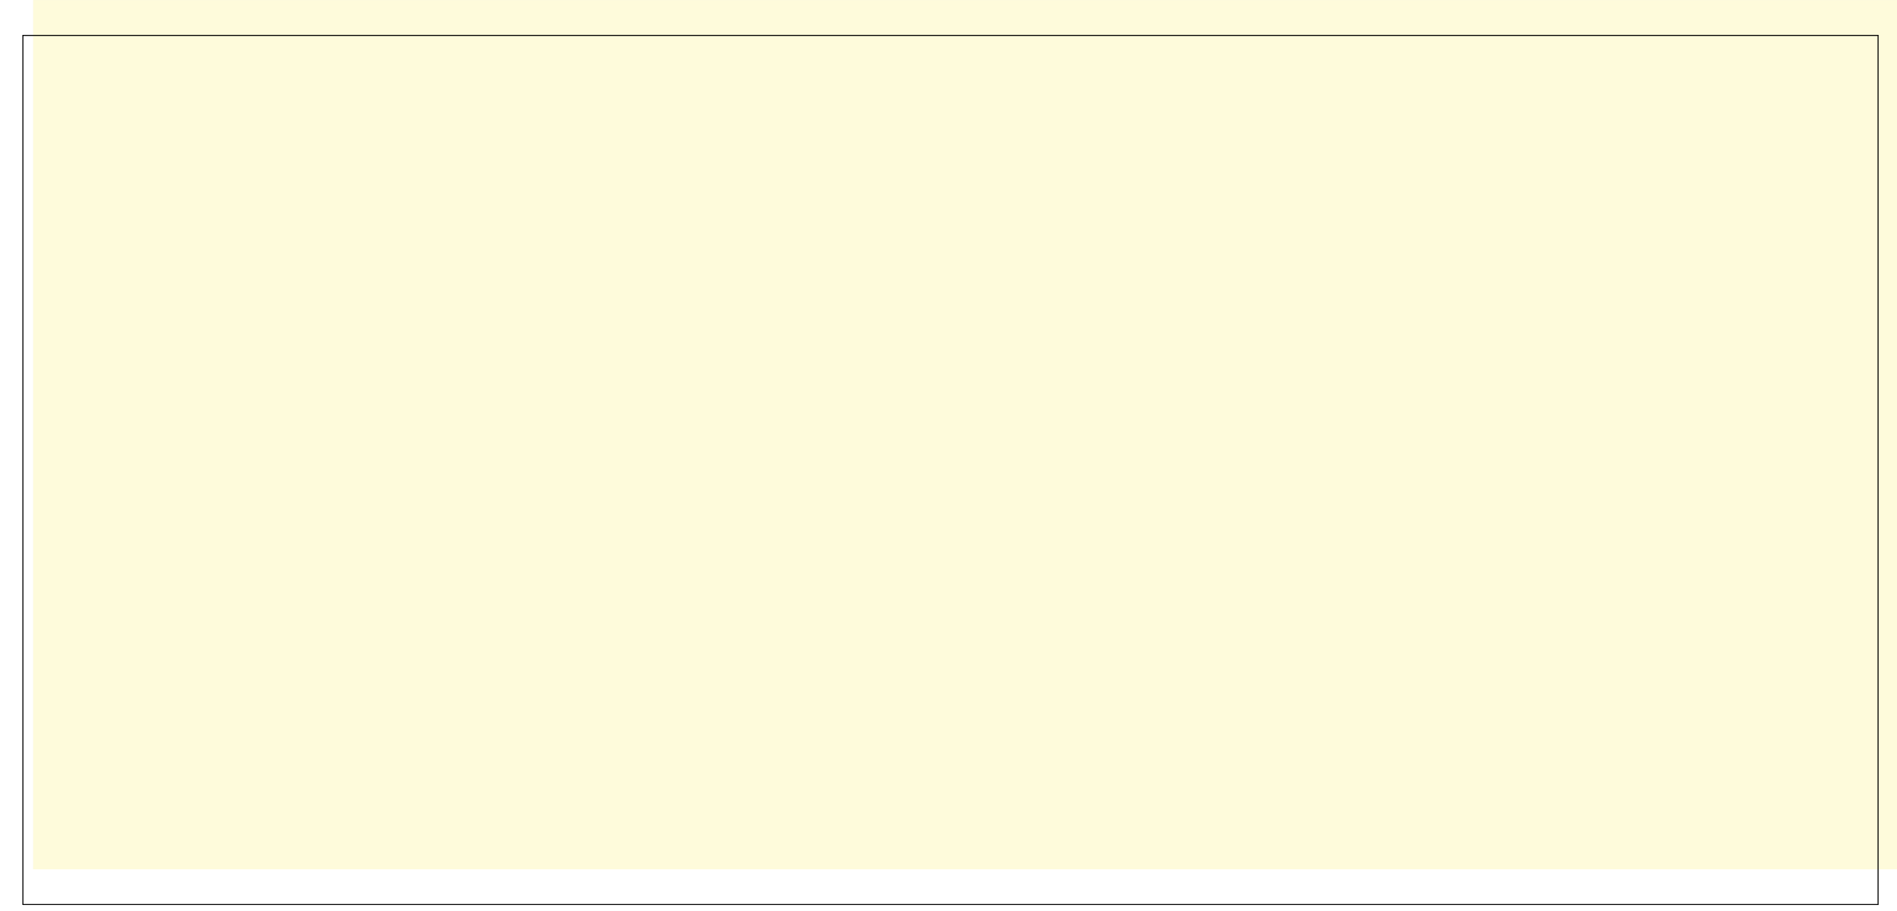
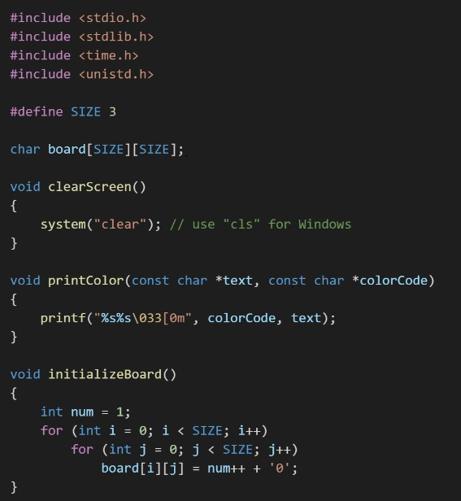
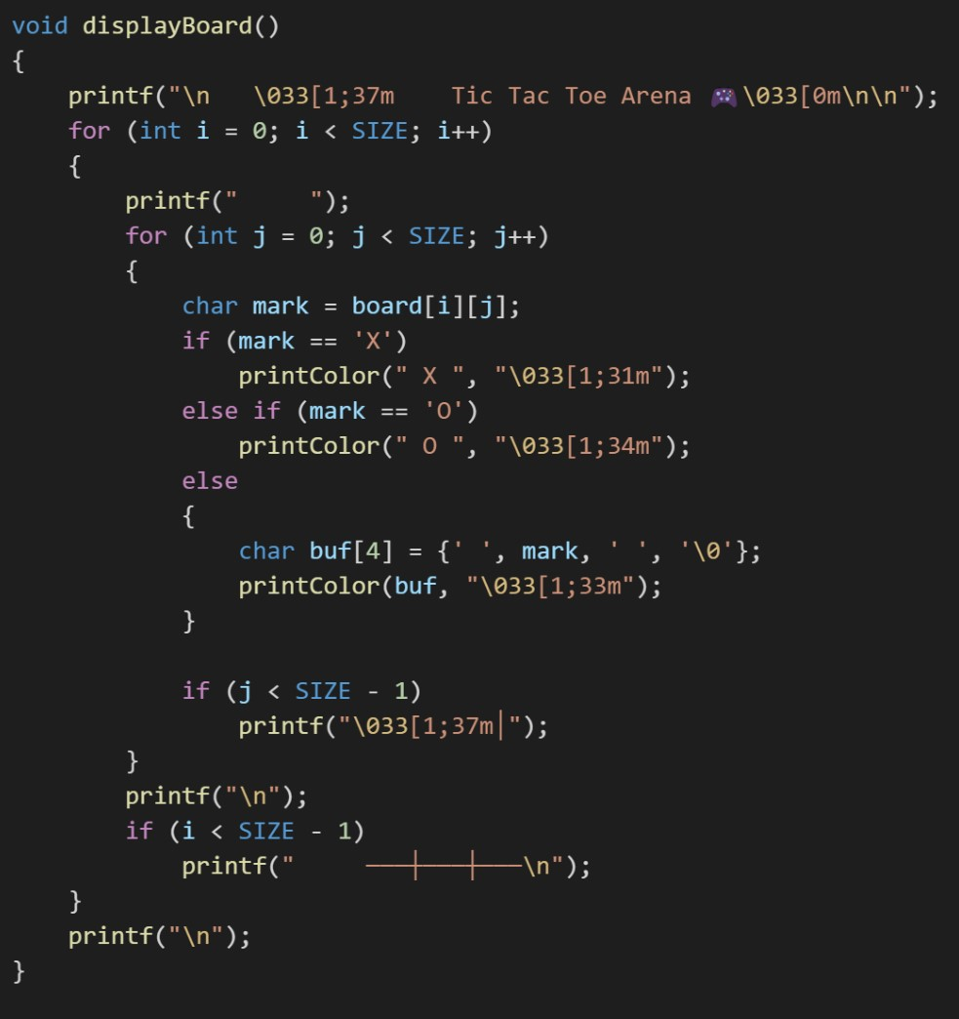
code structure
Project: 02 Team Member: S M Uday Haider, Kaniz Fatema Lubna, Asifur Rahman Apon, Safin Ahmed
Project: 02 Team Member: S M Uday Haider, Kaniz Fatema Lubna, Asifur Rahman Apon, Safin Ahmed

Slide 8
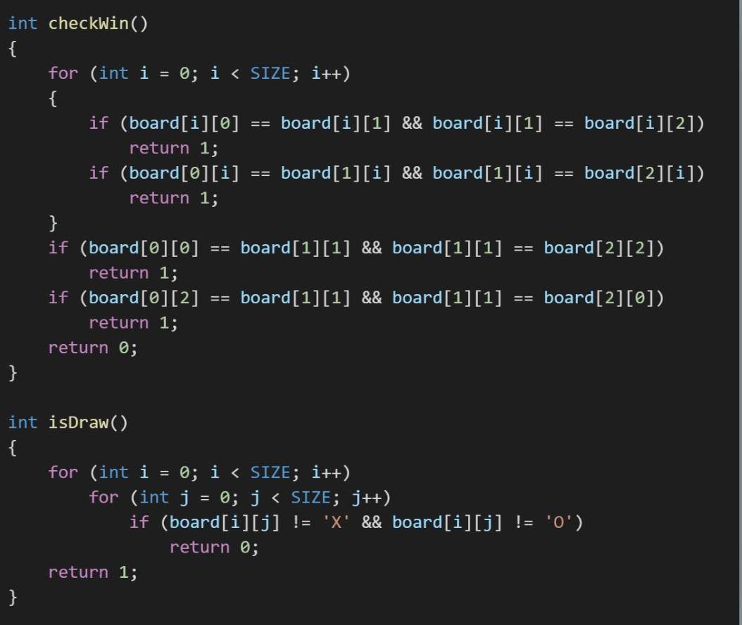
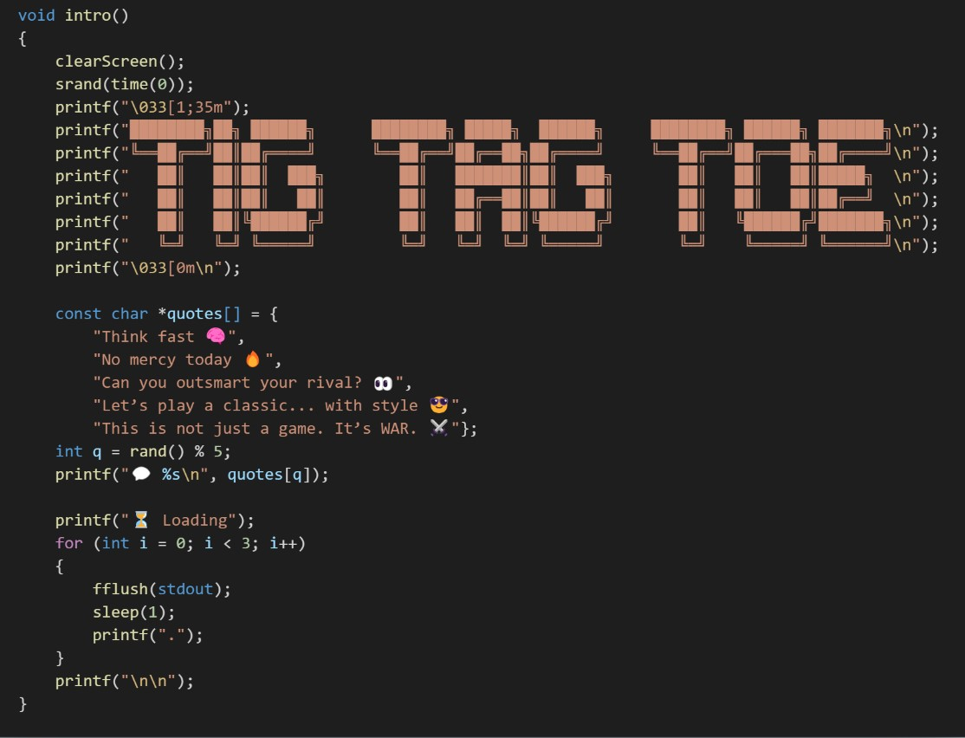
code structure
Project: 02 Team Member: S M Uday Haider, Kaniz Fatema Lubna, Asifur Rahman Apon, Safin Ahmed
Project: 02 Team Member: S M Uday Haider, Kaniz Fatema Lubna, Asifur Rahman Apon, Safin Ahmed

Slide 9
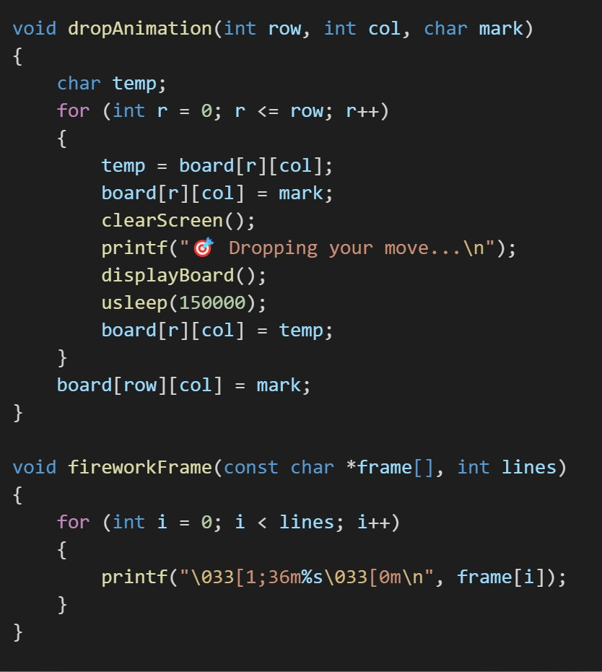
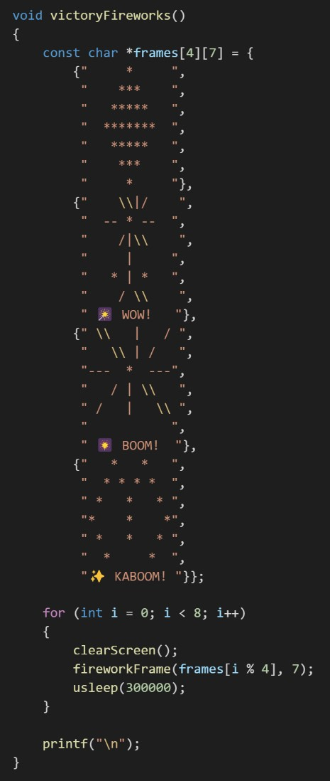
code structure
Project: 02 Team Member: S M Uday Haider, Kaniz Fatema Lubna, Asifur Rahman Apon, Safin Ahmed
Project: 02 Team Member: S M Uday Haider, Kaniz Fatema Lubna, Asifur Rahman Apon, Safin Ahmed

Slide 10
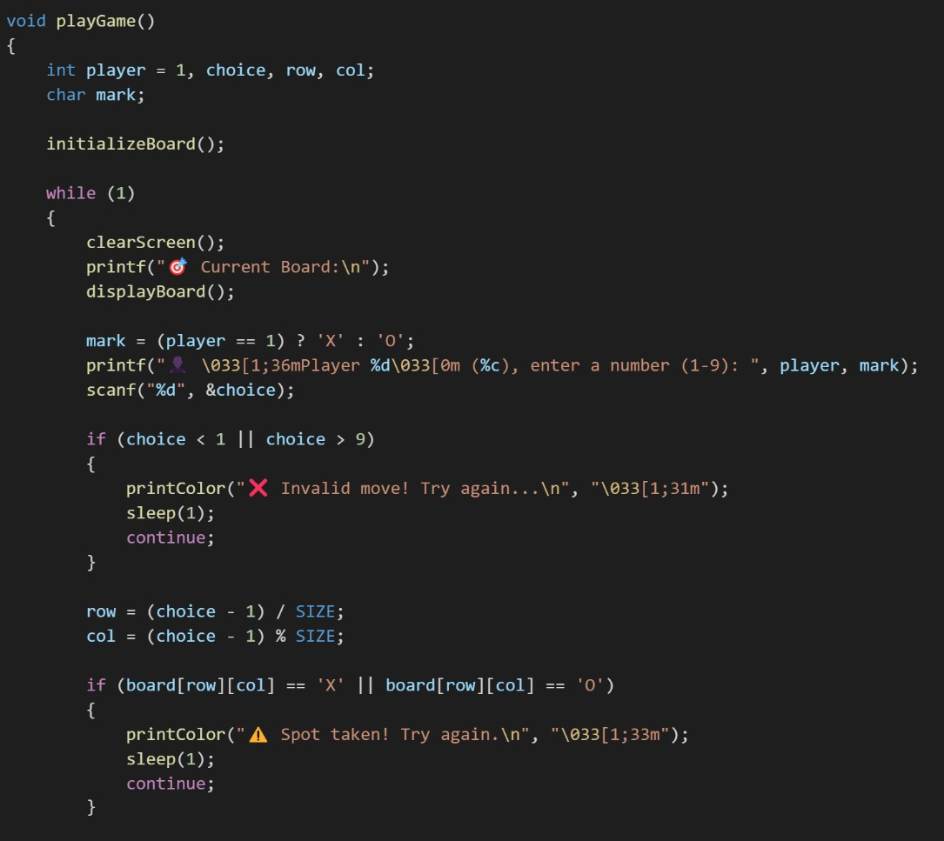
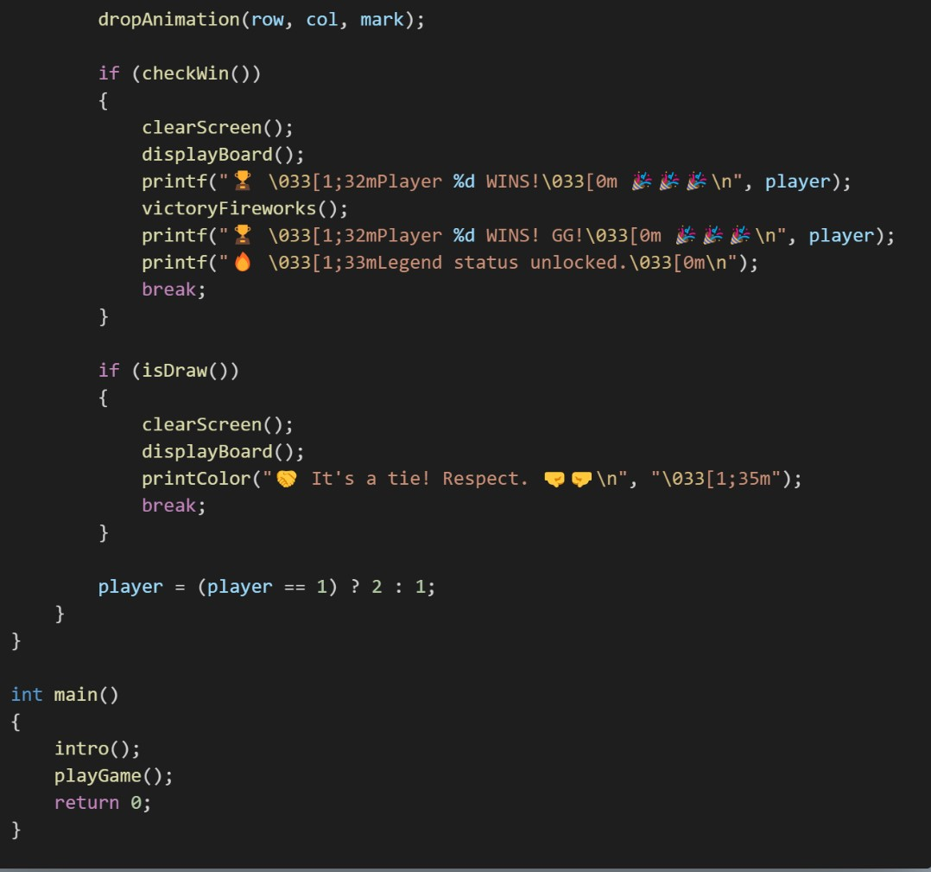
code structure
Project: 02 Team Member: S M Uday Haider, Kaniz Fatema Lubna, Asifur Rahman Apon, Safin Ahmed
Project: 02 Team Member: S M Uday Haider, Kaniz Fatema Lubna, Asifur Rahman Apon, Safin Ahmed

Slide 11
Modularity and Reusability
During the duration of the project, several valuable lessons came to light:
>Validate user input to prevent bugs and unwanted behavior at all times.
>Modular code makes future changes and debugging much easier.
Preplanning the game progression guarantees maintaining a clean design.
Regular testing during development guarantees finding issues early
Project: 02 Team Member: S M Uday Haider, Kaniz Fatema Lubna, Asifur Rahman Apon, Safin Ahmed

Slide 12
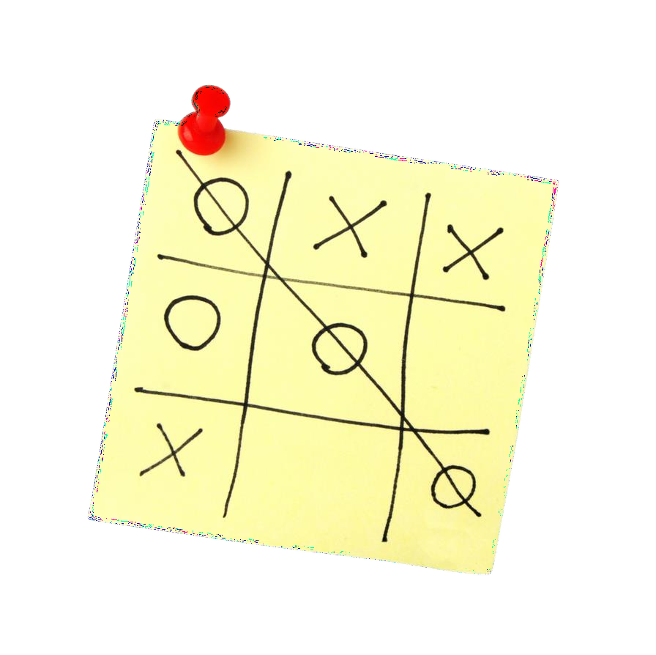

issues
￭Invalid Inputs
￭Out-of- Range Inputs
￭Occupied Cell Selection
Project: 02
Team Member: S M Uday Haider, Kaniz Fatema Lubna, Asifur Rahman Apon, Safin Ahmed

Slide 13
solutions
￭Improve input handling
￭Ensure correct player turn management
￭Prevent infinite loops and crashes
Project: 02
Team Member: S M Uday Haider, Kaniz Fatema Lubna, Asifur Rahman Apon, Safin Ahmed

Slide 14
methodology
DEVELOPMENT APPROACH:
￭Board Representation
￭Game Flow
￭Input Handling
￭Conclusion Checking
FUTURE ENHANCEMENTS:
￭AI implementation
￭Implementing input handling GUI
￭Introducing network based
multiplayer
Project: 02 Team Member: S M Uday Haider, Kaniz Fatema Lubna, Asifur Rahman Apon, Safin Ahmed

Slide 15






thank you :)

